Slide 1
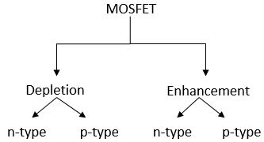
.
Metal oxide semiconductor field effect transistor

Slide 2
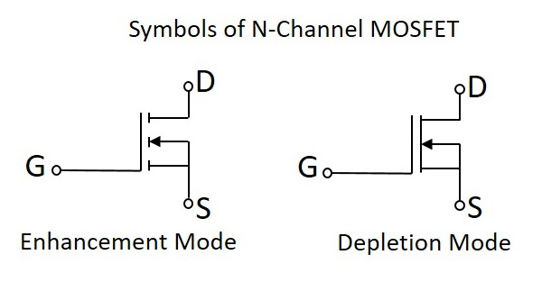

Slide 3
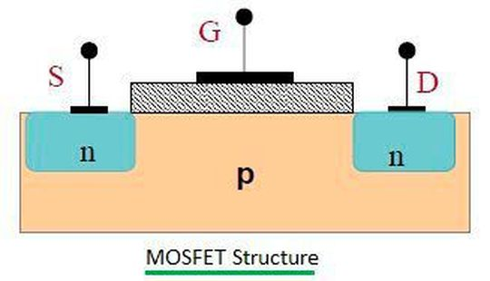

Slide 4
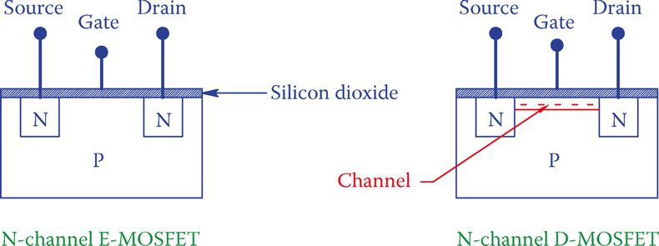
.

Slide 5
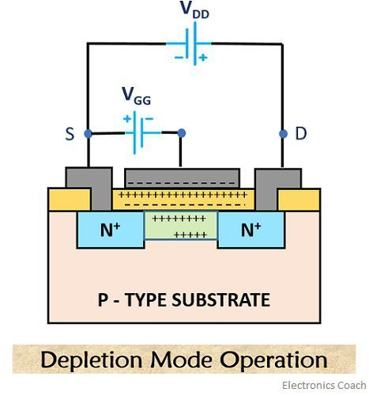

Slide 6
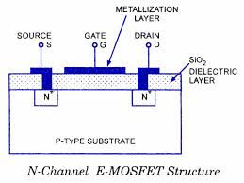

Slide 7
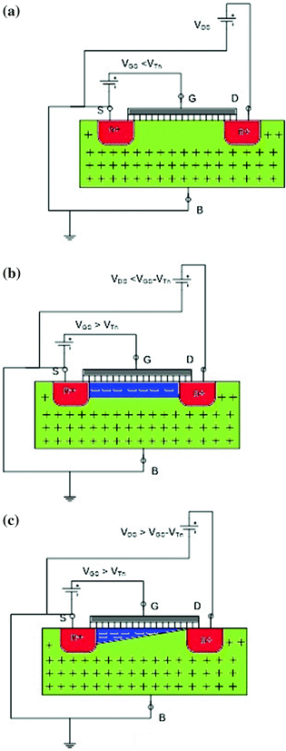

Slide 8
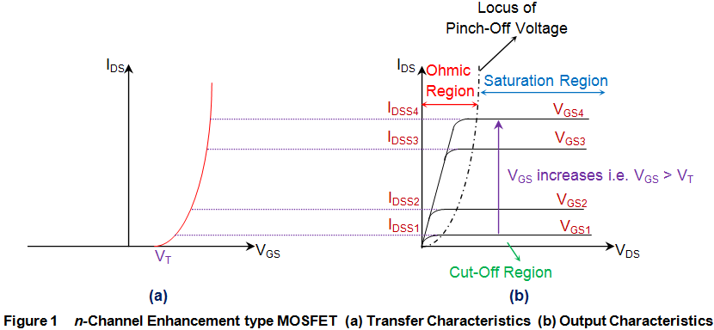
n-channel Enhancement type MOSFET

Slide 9
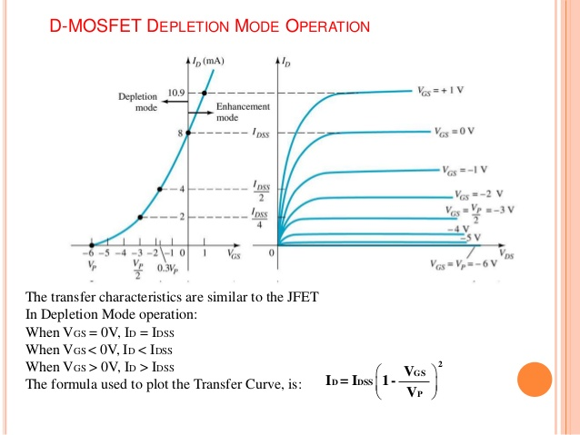

Slide 10
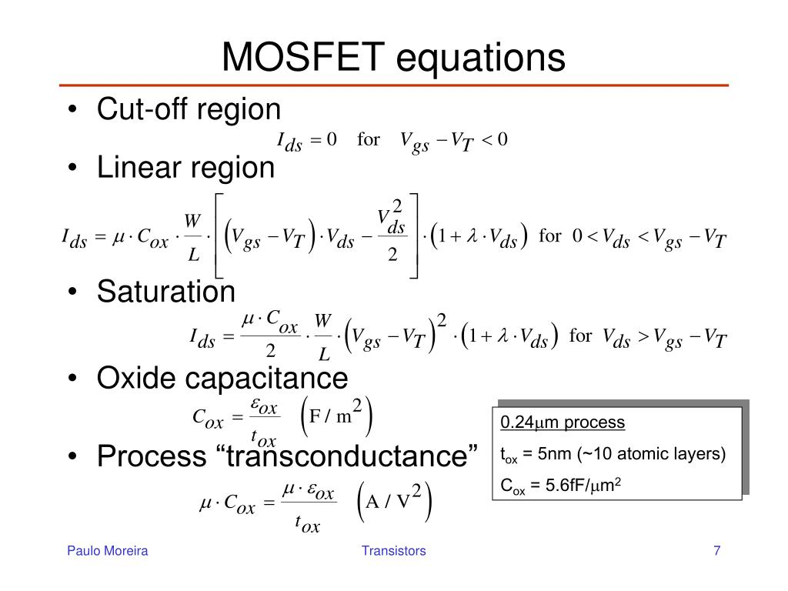

Slide 11
Q. In MOSFET devices the N-channel type is better than the P – Channel type in the following respects.
(a) It has better immunity
(b)It is faster
(c) It is TTL compatible
(d)It has better drive capability

Slide 12
Q.In a MOSFET, the polarity of the inversion layer is the same as that of the
(a) Charge on the GATE – EC – electrode
(b)Minority carries in the drain
(c) Majority carriers in the substrate
(d)Majority carries in the source

Slide 13
Q. Which of the following effects can be caused by a rise in the temperature?
(a) Increase in MOSFET current (IDS)
(b)Increase in BJT current (IC)
(c) Decrease in MOSFET current (IDS)
(d)Decrease in BJT current (IC)

Slide 14
Q. The drain of an n – channel MOSFET is shorted to the gate so that
Vgs = Vds . The threshold voltage (VT) of MOSFET is 1 V. If the drain current (ID) is 1 mA for Vgs = 2 V, then for Vgs = 3 𝑉, ID is
(a) 2 mA
(b)3 mA
(c) 9 mA
(d)4 mA

Slide 15
Q. When the gate – to – source voltage (VGS) of a MOSFET with threshold voltage of 400 mV, working in saturation is 900 mV, the drain current is observed to be 1 mA. Neglecting the channel width modulation effect and assuming that the MOSFET is operating at saturation, the drain current for an applied VGS of 1400 mV is
(a) 0.5 mA
(b)2.0 mA
(c) 3.5 mA
(d)4.0 mA

Slide 16
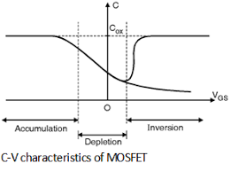
CV characteristics

Slide 17
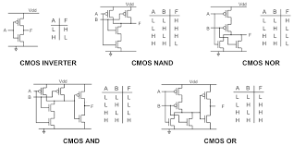
CMOS - Complementary metal oxide semiconductor

Slide 18
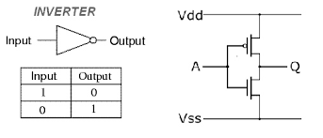
Example

